Slide 1


The Art and Science
of Unlimited Self-Healing
No Disease is Incurable
Extraordinarily Rapid
Physical Change is Possible

Slide 2
I Awake in Thy Light
I awake in Thy Light!
I awake in Thy Light!
I am joyful, I am free,
I awake in Thy Light!
I awake in Thy Love!
I awake in Thy Love!
I am joyful, I am free,
I awake in in Thy Love!
I awake in Thy Joy!
I awake in Thy Joy!
I am joyful, I am free,
I awake in Thy Joy!

Slide 3
Orientation
Introductions
Schedule
Sadhana
About Ananda

Slide 4
Program Goals for You
Understand your power for unlimited self-healing
as revealed in physics and spiritual science
Explore the healing power of emotion, belief, and connection to Spirit
Learn techniques to methodically use those transformative powers
Create your own self-healing plan

Slide 5
Begin Your Personal Self-Healing Plan
In your journal:
List your health issues and briefly describe what you think is causing them

Slide 6
The Physics of Unlimited Self-Healing
We must liberate man from the [physical]…in which, since the renaissance, he has been imprisoned. We now know that we…extend outside the physical continuum…. In time, as well as in space, the individual stretches out beyond the frontiers of his body…. He also belongs to another world.
—Dr. Alexis Carrel, Nobel Prize winner

Slide 7

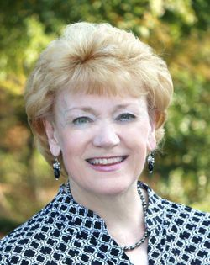
Three Extraordinary Stories
Anita Moorjani
Mr. Wright
Barbara Cummiskey

Slide 8
Modern medicine simply can’t explain any of these stories because its model of healing is biomechanical

Slide 9
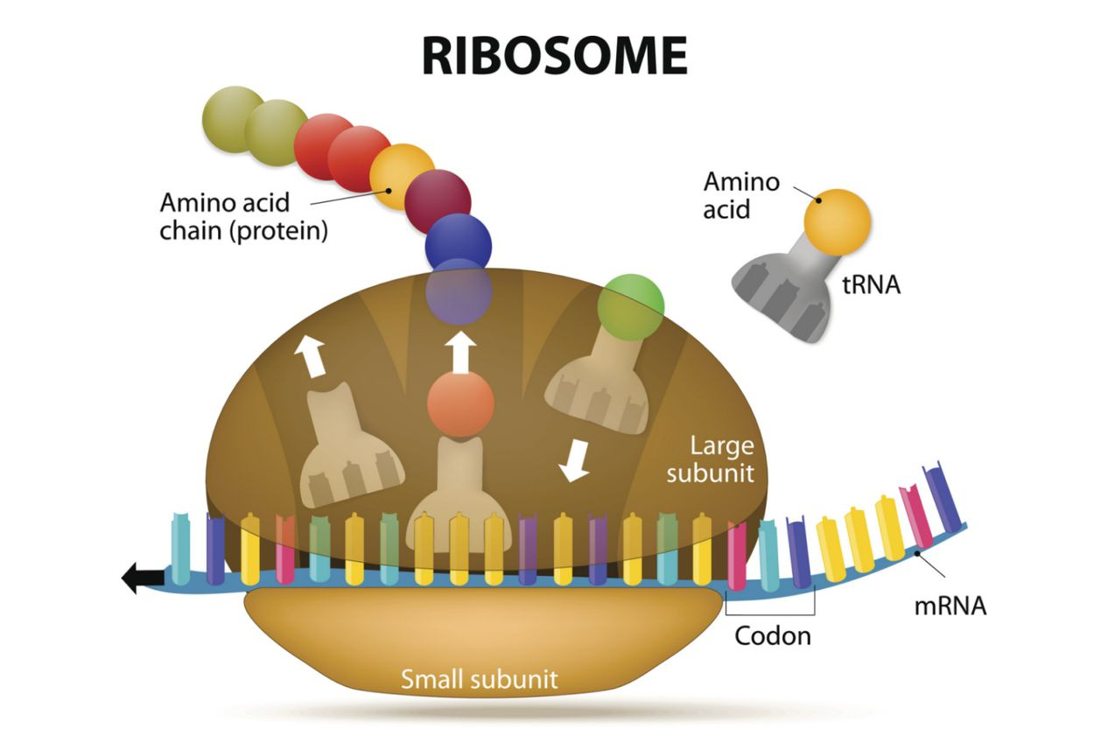

Slide 10
All Biomechanical Processes
Have Speed Limits
The maximum number of new proteins that can be biomechanically produced in a single day by all the ribosomes in every cell combined: 10²¹ (1 sextillion)
While an impressively enormous number, it is roughly one forty thousandth (1/40,000) of the total number of proteins in the body: 400x10²⁴ (400 septillion)

Slide 11
Cases of Extraordinarily Rapid Healing
Smash Biomechanical Speed Limits
Barbara Cummiskey’s body was healed in minutes.
Brain, spinal cord, and nerve cells remade
Atrophied muscles reformed
Weight gained
Even just one pound gained in minutes meant her body had to have produced thousands of times as many proteins as can be produced biomechanically in an entire day

Slide 12
Our Precise Life-Process Coordination Also Defies a Biomechanical Explanation
Over 50,000 life processes occur in every cell, every second
Our DNA simply doesn’t have enough genes to coordinate all life-processes
Epigenetics has shown that genes are routinely activated and deactivated
The nervous system is too slow to coordinate all life-processes

Slide 13
The Biomechanical Model is Incomplete
It can’t explain these two key and known phenomena:
1. Extraordinarily rapid physical change
2. Incredibly precise life-process coordination
Modern energy physics and spiritual science, however, do have explanations for these phenomena

Slide 14
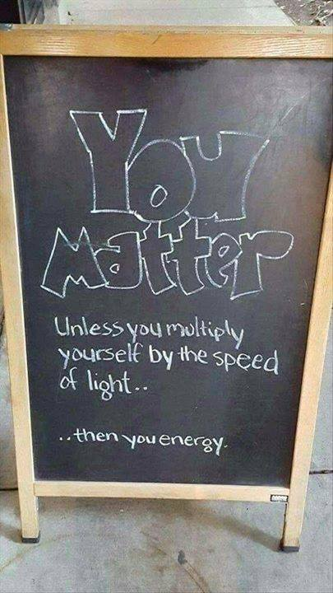
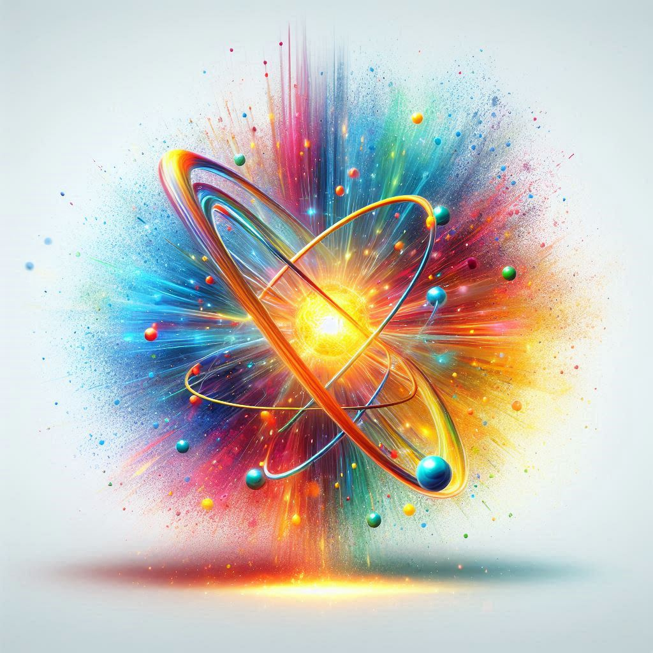
Matter is Energy

Slide 15
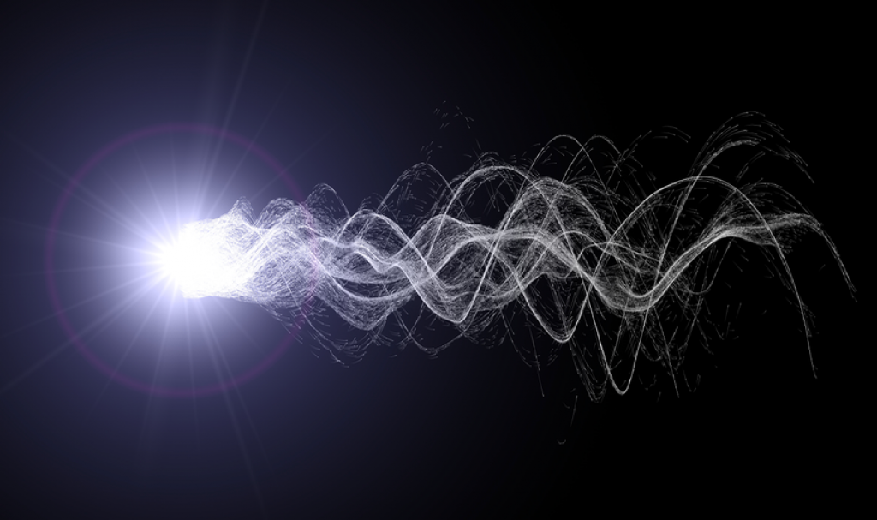
Energy Can Behave as Particles or Waves

Slide 16
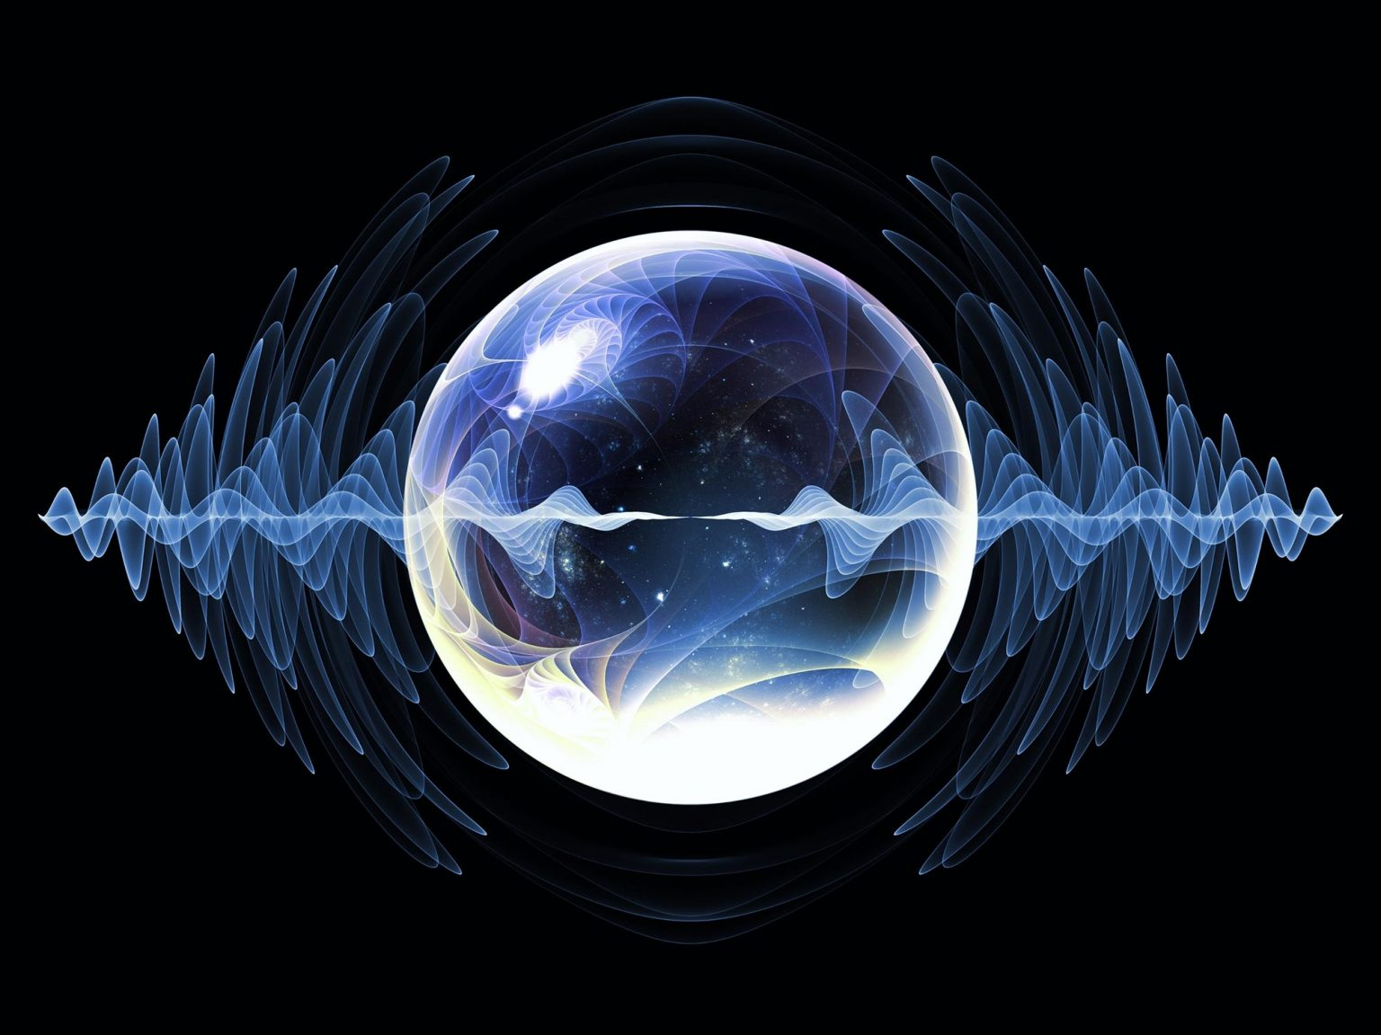
Energy Exists Both Locally and Nonlocally

Slide 17
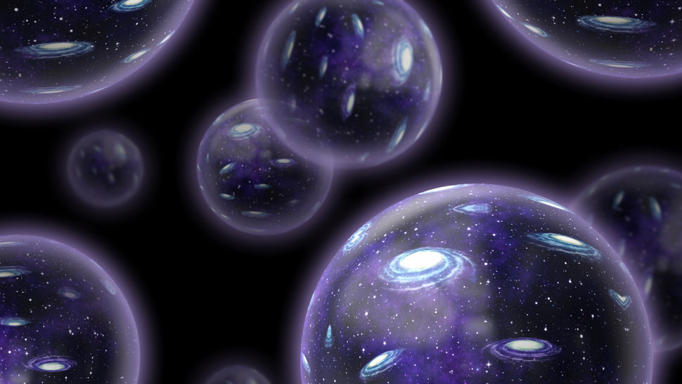
Nonlocality is Vast

Slide 18
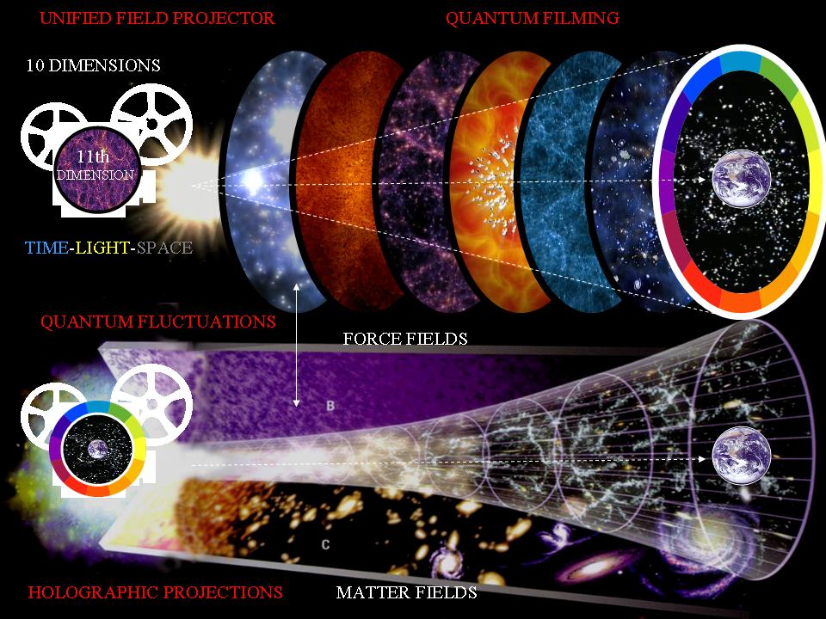
Nonlocality Has a Structure

Slide 19
The Universe is a Holographic Projection
The three-dimensional world of ordinary experience––the universe filled with galaxies, stars, planets, houses, boulders, and people––is [contained in] a hologram, an image of reality coded on a…two-dimensional surface.
—Dr. Leonard Susskind, Stanford professor and leading M-theorist

Slide 20
The Lowest Brane Layer Contains the Hologram for the Universe

Slide 21
The Universe is Continuously Created

Slide 22
What does all this mean for the human body?

Slide 23
Our Body Exists in Multiple Realities
[The body is] rather like a beautiful, exotic flower, flickering in and out of many dimensions simultaneously.—Mae-Wan Ho, quantum biologist
We, and all things in the universe, are non-locally connected with each other and with all other things in ways that are unfettered by the hitherto known limitations of space and time.—Ervin Laszlo

Slide 24

The Physical Body (Like the Universe) is Continuously Holographically Created

Slide 25
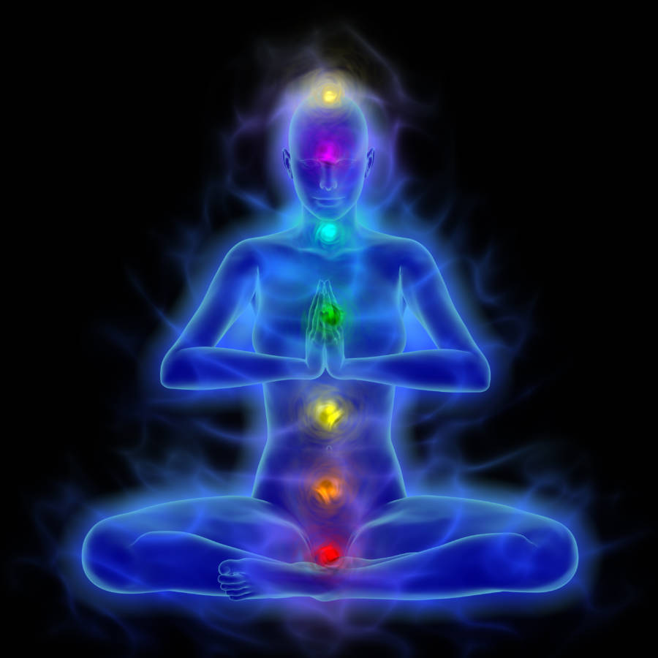
The Physical Body (Like the Universe) is Projected from a Nonlocal Hologram

Slide 26
Our Body is Simultaneously
Biomechanical and Holographic

Slide 27
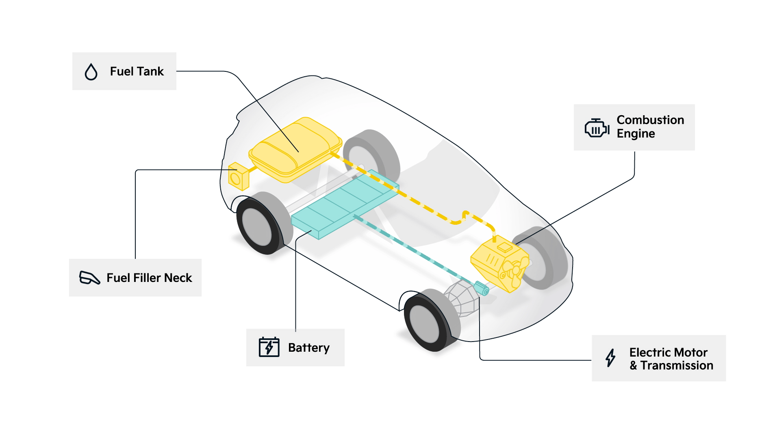
Like a Hybrid Car: Simultaneously
Internal Combustion and Electric

Slide 28
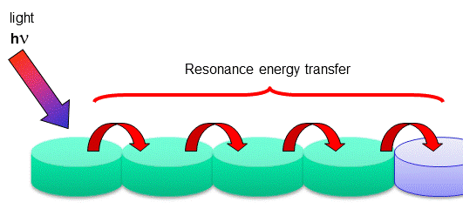
Hybrid Behavior in Nature

Slide 29
Hybrid Behavior in the Human Body
Billions of neurons in the brain change firing frequency routinely and simultaneously
Biophotons are emitted in the same phase and frequency
More or less of the body can behave biomechanically or holographically at any given time

Slide 30
Hybrid behavior gives us an explanation for extraordinarily rapid physical change:
Because our body can simultaneously behave both biomechanically and holographically, biomechanical limits, such as the speed of protein production, can be augmented or superseded by instantaneous and unlimited holographic change
But this doesn’t explain incredibly precise life-process coordination. For that we need to turn to spiritual science

Slide 31
Intelligently Guided Life Force
[There is] a kind of superintelligence that exists in each of us, infinitely smarter and possessed of technical know-how far beyond our present understanding.—Dr. Bernie Siegel, author of Love, Medicine, and Miracles
The astral body/hologram is a minutely and responsively changing movie-like pattern of intelligently guided life force
Life force holographically creates and biomechanically maintains the physical body according to that intelligently coordinated pattern

Slide 32
We Deeply Experience Our Astral Body
The seat of our mind’s eye view
Where we experience emotion
Where we “think”
The storehouse of memory
The origin of our ability to perceive through the senses
and use the body

Slide 33
Our Life Force Continuously Coordinates Life-Processes at All Levels—Atomic, Cellular, and Systemic
Crystallization
Circulation
Digestion
Procreation
Elimination

Slide 34
Causal Body
Powerful, intelligent, causative thought, contained in the causal body, determines what the astral body can do, which in turn determines what the physical body can do

Slide 35
The Soul
Our Soul, an individualized expression of Spirit, uses the powers of Spirit to create and enable all three bodies
Our Soul-originating, free-willed choices, actions, emotions, and thoughts—positive or negative— reverberate through all three bodies—causal, astral, and physical

Slide 36
Summary Points
The physical body is not physical
The physical body is not independent
Our multiple bodies are a seamless and minutely responsive whole made of energy and thought
Soul and Spirit’s innate intelligence
coordinates all life-processes
Our body is a continuous miracle

Slide 37
The Art of Unlimited Self-Healing
When we begin to understand the total
being that is man, we realize that he is no simple physical organism. Within him are many powers whose potential he employs in greater or lesser degree in accommodating himself to the conditions of this world. Their potential is vastly greater than the average person thinks.
—Paramhansa Yogananda

Slide 38
Soul Powers
Most of our health, good or bad,
is the result of three Soul powers:
Emotion
Belief
Connection to Spirit

Slide 39
Emotions Can Kill or Heal
Anita Moorjani—Fear killed her and love healed her
Stress—the result of a potent mixture of negative emotions—is believed to be the primary cause of 85% to 95% of all ill-health, disease, and premature death from illnesses including cancer
The decades long Grant Study showed a conclusive connection between negative emotional health and poor physical health and premature death

Slide 40
What is emotion?
Emotion is the movement of life force
in the astral body
Moving upward or downward
Moving in consistent patterns
Which affect, positively or negatively,
consistent areas of the physical body

Slide 41
Negative Emotion v. Positive Emotion
Negative emotions are negative because we don’t like how they “feel” but they are also negative because they disrupt our life force’s ability to coordinate and execute life-processes
Positive emotions not only feel better but they support our life force’s ability to coordinate and execute life-processes

Slide 42
Short-Term and Long-Term Effect
Strong negative emotion powerfully disrupts life-process coordination and execution
If short-term, any disruption can be reversed by the return of steady, positive, harmonious emotion
If long-term, however, continuous disruption leads to cellular breakdown
Cellular breakdown is the beginning of all disease and can lead to terminal illness

Slide 43
Negative Emotion and Mood
A habit of strong and frequent negative emotional responses to life situations, such as fear, anger, anxiety, or hatred leads to cellular breakdown and disease
Mild but continuous negative emotion, otherwise known as mood, such as sadness, depression, despair, shame, or grief (often harbored in secret or not even recognized) will also lead to cellular breakdown and disease

Slide 44
How to Overcome Negative Emotions
Most people think they must change the life circumstances that they believe are causing their negative emotions
Many people try to “release” negative emotions
The most effective way to overcome negative emotions, however, is to create or cultivate positive emotions

Slide 45
Lift Your Energy
Energy and joy go hand in hand. –Yogananda
Work directly with life force
Increase your flow of life force by energization
Say “yes” to life

Slide 46
Lift Your Heart
Joy and energy go hand in hand. –Yogananda
Consciously lift your heart through singing and chanting
Get a positive “sound track” going every day

Slide 47
I Awake in Thy Light
I awake in Thy Light!
I awake in Thy Light!
I am joyful, I am free,
I awake in Thy Light!
I awake in Thy Love!
I awake in Thy Love!
I am joyful, I am free,
I awake in in Thy Love!
I awake in Thy Joy!
I awake in Thy Joy!
I am joyful, I am free,
I awake in Thy Joy!

Slide 48
Next Step for Your
Personal Self-Healing Plan
In your journal:
List the practices or techniques for cultivating positive emotions, just shared, that appeal to you.
Include other practices or techniques for cultivating positive emotions that appeal to you which you already know or practice.
Increase your flow of life force by energization
Say “yes” to life
Consciously lift your heart through singing and chanting
Get a positive “sound track” going every day

Slide 49
Belief, Too, Can Kill or Heal
Mr. Wright
Placebo effect
Multiple personality disorder sufferers
Belief activates or deactivates genes
Belief shapes and directs your astral body, the astral body, in turn, directs your life force

Slide 50
Cultivate Unlimited Beliefs
Convince your mind that all human methods of cure are limited in their healing power, and that only God’s all-permeating, all-healing power is unlimited. –Yogananda
Read uplifting books, watch uplifting videos:
Spiritual teachings, biographies of saints, moving life stories, near-death experiences, stories of cancer survivors, stories of miraculous healings

Slide 51
Practice Unlimited Affirmations
General help or specific antidote:
My body cells obey my will: They dance with divine vitality! I am well! I am strong! I am a flowing river of boundless power and energy!
I accept with calm impartiality whatever comes my way. Free in my heart, I am not conditioned by any outward circumstance. Whatever comes of itself, let it come.

Slide 52
Practice Unlimited Visualization
Visualize your physical body or specific parts of your physical body whole and well, shining with astral light
Visualize healing taking place
Add visualization to your affirmation
My body cells obey my will: They dance with divine vitality! I am well! I am strong! I am a flowing river of boundless power and energy!

Slide 53
How to Practice Affirmations
Out loud
More and more softly
Silently
More and more inwardly
Connect to your superconscious
“Feel” the inspiring truth of your affirmation

Slide 54
Let’s Practice Together
My body cells obey my will: They dance with divine vitality!
I am well! I am strong!
I am a flowing river of boundless power and energy!

Slide 55
Keys to Successful Affirmation or Visualization
Consistently practice just one affirmation or visualization (or affirmation and visualization combined) over a period of time—be patient
Practice your affirmation or visualization at the end of your meditation
Practice your affirmation or visualization until you feel a divine superconscious connection to its truth
Practice your affirmation or visualization until you believe it or feel it

Slide 56
Next Step for Your
Personal Self-Healing Plan
In your journal:
List the practices or techniques for developing unlimited beliefs, just shared, that appeal to you.
Include other practices or techniques for developing unlimited beliefs that appeal to you that you already know or practice.
Read uplifting books, watch uplifting videos
Practice unlimited affirmation
Practice unlimited visualization

Slide 57
Connecting to Spirit
Barbara Cummiskey
Spirit is ever-existing, ever-conscious, ever-new Joy!
Connecting to Spirit supercharges your positive emotions and overcomes all fear
Connecting to Spirit transforms your beliefs through
direct experience

Slide 58
Ways to Connect to Spirit
Meditation
Devotion
Chanting
Prayer
Service

Slide 59
Let’s Chant and Meditate Together
I awake in Thy Light!
I awake in Thy Light!
I am joyful, I am free,
I awake in Thy Light!
I awake in Thy Love!
I awake in Thy Love!
I am joyful, I am free,
I awake in in Thy Love!
I awake in Thy Joy!
I awake in Thy Joy!
I am joyful, I am free,
I awake in Thy Joy!

Slide 60
Final Steps for Your
Personal Self-Healing Plan
In your journal:
List the practices or techniques for connecting to Spirit just shared that appeal to you.
Include other practices or techniques for connecting to Spirit that appeal to you that you already know or practice.
Meditation
Devotion
Chanting
Prayer
Service

Slide 61
Prioritize Your
Personal Self-Healing Plan
In your journal:
From all your lists, choose the top five to seven practices or techniques for cultivating positive emotions, developing unlimited beliefs, or connecting to Spirit you think would be the most effective for you.

Slide 62
Choose just one new practice!
Be methodical in establishing your practice
What, when, where, and how
Practice it until it becomes a habit
Then choose the next practice or technique from your list

Slide 63
Review and Improve Your Plan
Regularly review your progress, at least weekly, for one year
When you review, write in your journal:
What has been working
What hasn’t been working
What you will do to improve your practices

Slide 64
I Awake in Thy Light
I awake in Thy Light!
I awake in Thy Light!
I am joyful, I am free,
I awake in Thy Light!
I awake in Thy Love!
I awake in Thy Love!
I am joyful, I am free,
I awake in in Thy Love!
I awake in Thy Joy!
I awake in Thy Joy!
I am joyful, I am free,
I awake in Thy Joy!

